Slide 1
Lesson objective
Aim – to be able to:
Calculate the percentage of an amount without a calculator
Plan:
Divide and build with percent
Finding the percent of an amount
PBS Focus: growth without adversity
Need whiteboards

Slide 2
25%
50%
10%
100%
5%
1%

Slide 3
25%
÷ 4
50%
÷ 2
10%
÷ 10
100%
÷ 2
5%
÷ 20
1%
÷ 100

Slide 4
15%?
25%
÷ 4
50%
÷ 2
10%
÷ 10
100%
÷ 2
5%
÷ 20
1%
÷ 100

Slide 5
60%?
25%
÷ 4
50%
÷ 2
10%
÷ 10
100%
÷ 2
5%
÷ 20
1%
÷ 100

Slide 6
7%?
25%
÷ 4
50%
÷ 2
10%
÷ 10
100%
÷ 2
5%
÷ 20
1%
÷ 100

Slide 7
9%?
25%
÷ 4
50%
÷ 2
10%
÷ 10
100%
÷ 2
5%
÷ 20
1%
÷ 100

Slide 8
30%?
25%
÷ 4
50%
÷ 2
10%
÷ 10
100%
÷ 2
5%
÷ 20
1%
÷ 100

Slide 9
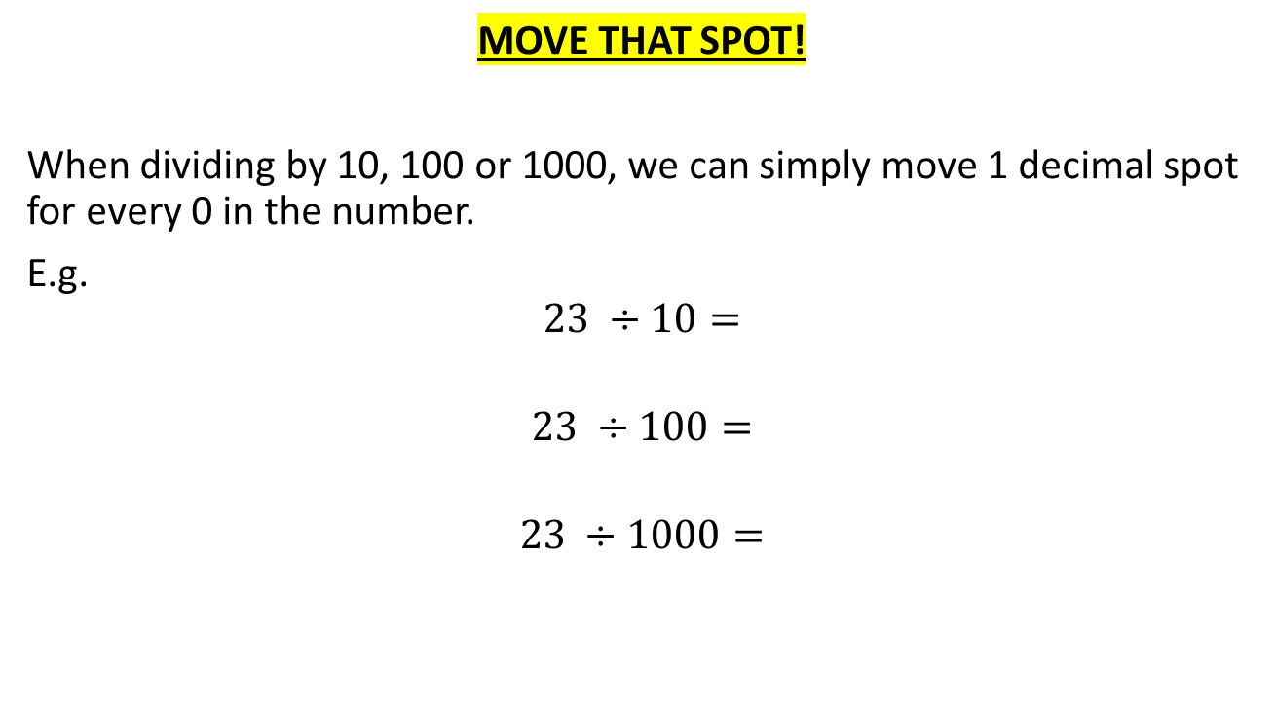
How many zero’s you got?
MOVE THAT SPOT!
When dividing by 10, 100 or 1000, we can simply move 1 decimal spot for every 0 in the number.
E.g.
$$23 ÷10=$$
$$23 ÷100=$$
$$23 ÷1000=$$

Slide 10
Whiteboards
Remember: how many zeros = number of spots to move
$$140 ÷10=$$
$$140 ÷100=$$
$$53 ÷10 =$$
$$5 ÷100=$$

Slide 11
Why was that important?
Well, when we need to find the percentage of something its handy to have these little tricks.
If I wanted 10% of $240
Well 10% ➔ $\frac{10}{100}$➔ simplifies to $\frac{1}{10}$
So the question is asking for $\frac{1}{10}$of $240
How many zero’s?
Move that spot
10% of $240 = $24

Slide 12
Examples
1% of 890
10% of 240
10% of 356
5% of 240
(refer to notes)
20% of 240
(TPS)

Slide 13
Problem solving
What if I wanted to find the percentage of an amount, but the percent was something tricky like…. 65% of 240?
What is a strategy I could use?
30 seconds, think pair and share.
A: build up from 10% using the simple steps or take 35% from 240

Slide 14
WHITEBOARDS READY

Slide 15
What is 50% of £80?

Slide 16
What is 25% of £120?

Slide 17
What is 10% of £90?

Slide 18
What is 1% of £600?

Slide 19
What is 5% of £140?

Slide 20
What is 10% of £13?

Slide 21
What is 50% of 7kg?

Slide 22
What is 5% of 1 hour?

Slide 23
What is 35% of £60?

Slide 24
Whiteboards
Find 10%, 5% and 1% of the following amounts
$80
120
1500
Find 85% of 160

Slide 25
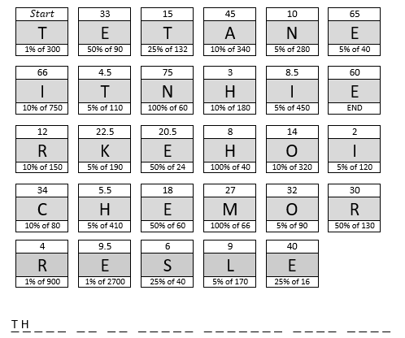

Slide 26
E R E I S N O O T H E R T E A C H E R L I K E M I N E

Slide 27
25%
Calculate:
30% of £40
82% of £40
93% of £40
50%
10%
£40
5%
1%

Slide 28
25%
£10
Calculate:
30% of £40
82% of £40
93% of £40
50%
£20
10%
£4
£40
5%
£2
1%
£0.40

Slide 29
25%
£10
Calculate:
30% of £40
30% = 10% x 3
= £4 x 3
= £12
82% of £40
93% of £40
50%
£20
10%
£4
£40
5%
£2
1%
£0.40

Slide 30
25%
£10
Calculate:
30% of £40
30% = 10% x 3
= £4 x 3
= £12
82% of £40
82% = 50% + 30% + 1% + 1%
= £20 + £12 + £0.40 + £0.40
= £32.80
93% of £40
50%
£20
10%
£4
£40
5%
£2
1%
£0.40

Slide 31
25%
£10
Calculate:
30% of £40
30% = 10% x 3
= £4 x 3
= £12
82% of £40
82% = 50% + 30% + 1% + 1%
= £20 + £12 + £0.40 + £0.40
= £32.80
93% of £40
93% = 100% - 5% - 1% - 1%
= £40 - £2 - £0.40 - £0.40
= £37.20
50%
£20
10%
£4
£40
5%
£2
1%
£0.40

Slide 32
a) 20% of £60
b) 15% of £120
c) 35% of £80
d) 40% of £90
e) 60% of £250
f) 75% of £160
g) 52% of £200
h) 27% of £40
i) 95% of £140
j) 84% of £80
k) 66% of £50
l) 14% of £320
Which is greater? :
m) 45% of £30
or 55% of £25?
n) 70% of 50p
or 6% of £7?
o) 7% of 80cm
or 3% of 2m?

Slide 33
a) 20% of £60
£12
b) 15% of £120
£18
c) 35% of £80
£28
d) 40% of £90
£36
e) 60% of £250
£150
f) 75% of £160
£120
g) 52% of £200
£104
h) 27% of £40
£10.80
i) 95% of £140
£133
j) 84% of £80
£67.20
k) 66% of £50
£33
l) 14% of £320
£44.80
Which is greater? :
m) 45% of £30
or 55% of £25?
n) 70% of 50p
or 6% of £7?
o) 7% of 80cm
or 3% of 2m?

Slide 34
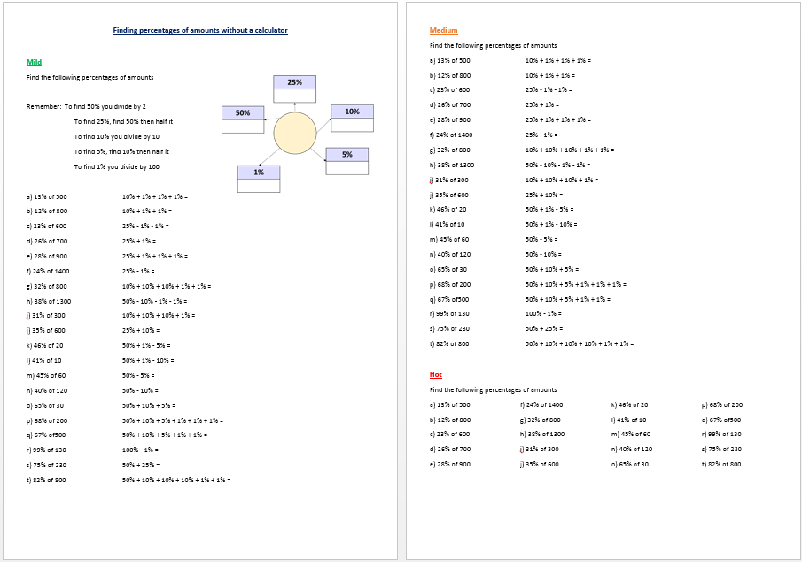

Slide 35
ANSWERS
a) 6.5
b) 96
c) 138
d) 182
e) 252
f) 336
g) 256
u) If Bobby went to the shop and there was a 25% sale. He was going to buy a top for £22.
How much does Bobby save? £5.50 What is the new price of the top? £17.50
v) If Sarah went to the shop and there was a 15% sale. She was going to buy 7 CDs for £60.
How much does Sarah save? £9 What is the new price of the CDs? £51
o) 18.5
p) 136
q) 335
r) 128.7
s) 172.5
t) 96
h) 468
i) 33
j) 210
k) 8
l) 4.4
m) 27
n) 48

Slide 36
What do you notice?
Does this always work?
Will it work if you change 50 to a different number?
Try to prove your findings.
Find 50% of 2020
Find 2020% of 50
Find 50% of 98
Find 98% of 50

